Slide 1
Week 5: Color
Visit www.worldofteaching.com
For 100’s of ree powerpoints

Slide 2
28.1: The Color Spectrum
•Isaac Newton was the first to make a systematic study of color. He did this by passing a narrow beam of sunlight through a triangular-shaped glass prism
•His method showed that sunlight is composed of a mixture of all the colors of the rainbow.
•This selection of colors is called a spectrum: red, orange, yellow, green, blue, and violet.

Slide 3
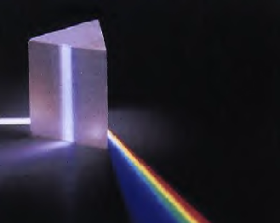
Triangular Prism

Slide 4
28.1: cont…
•True colors- Newton showed that colors in the spectrum were a property of white light. All the colors added together make white.
•Black is not considered a true color, but it is the absence of light. Objects that are black absorb all other light frequencies. You can see black objects because they cannot absorb all the light, otherwise you would not be able to see the object.

Slide 5

28.1: cont…
•Sunlight is an example of white light. Under white light objects that are white will appear white and objects that are colored will show their color

Slide 6
28.2: Color by Reflection
Objects are a certain color because of the light they reflect. (Ex. Red objects are red because they reflect red light.)
Molecules are made up of atoms. Atoms contain protons and neutrons. The electrons orbit the nucleus of the atom. These electrons can be excited to higher states and can send out energy waves.

Slide 7
28.2: cont…
Different elements have different frequencies for absorbing and emitting radiation. Reflection is when light is bounced back to the source from where it came. When something is transparent the light is not bounced back, but simply transmitted through.

Slide 8
28.2: cont…
An object can reflect only light of the frequencies present in the illuminating light. The appearance of a colored object therefore depends on the kind of light used to illuminate it.
Colors in the daylight appear different from the way they appear when illuminated with manmade lamps. The color seen from an object is subjective and depends on the source of the light.

Slide 9
28.3: Color by Transmission
The color of a transparent object depends on the color of the light that is transmits. A piece of blue glass transmits blue light.
Pigment is the material in the transparent glass that selectively absorbs colored light.

Slide 10
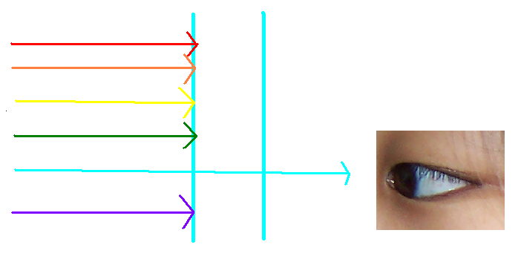
Light transmitting through blue glass
Notes:
Blue glass transmits only energy of the frequency of blue light; energy of the other frequencies is absorbed and warms the glass

Slide 11
28.3: cont…
Electrons in the pigment selectively absorb light of certain frequencies in the illuminating light.
Light that is not part of the selective frequencies is reemitted from atom to atom in the glass.
Ordinary window glass is colorless and it transmits all colors and visible frequencies of light.

Slide 12
28.4: Sunlight
The light from the sun is a composite of all the visible frequencies.
The color frequencies have uneven brightness.
Yellow-green light is the brightest part of sunlight, (the most heat).

Slide 13
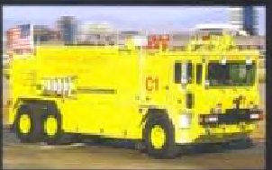
28.4: cont…
The human eye is most sensitive to yellow- green, which is why more new fire engines are painted this color; it attracts attention easier. Yellow- green is also easy to see at night because of their illuminating properties

Slide 14
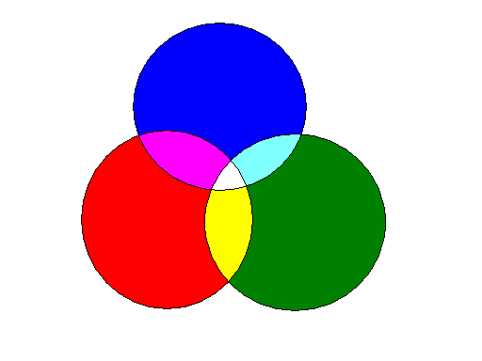

28.5 Mixing Colored Light
When red, blue, and green light are projected onto a screen, the overlapping areas appear different colors. Where all the three overlap, white is produced.
RED + GREEN =YELLOW
RED+ BLUE = MAGENTA
GREEN + BLUE = CYAN
Additive primary colors are red, blue, and green because these colors produce the highest number of different colors.

Slide 15
28.6: Complementary Colors
When two colors are added together to produce white, they are called complementary colors.
YELLOW + BLUE =WHITE ( Yellow a combination of Green + Red )
MAGENTA + GREEN = WHITE ( Magenta a combination of red + blue)
CYAN + RED = WHITE ( Cyan a combination of green+ blue)
Notes:
Yellow are complemntary colors because yellow, after all is a combination of green and red.

Slide 16
28.6: cont…
For example : if white light falls on a pigment that absorbs red light, the light reflected appears cyan.
Not all light incident upon an object is reflected. The ones that are absorbed are subtracted from the incident light.
Whenever you subtract a color from white light, you end up with the complementary color.

Slide 17
27.7 Mixing Colored Pigments
-Mixing red, green, and blue paint is entirely different from the mixing of colored light.
-Pigments absorb light of a relatively wide range of frequencies.
-Subtractive primary colors are three paint or dye colors that are more useful in color mixing by subtraction are MAGENTA, YELLOW, and CYAN

Slide 18
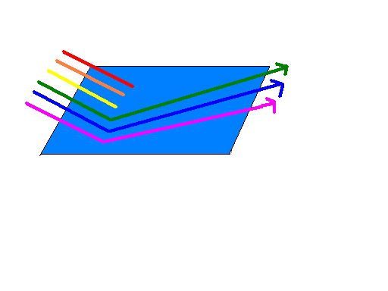
Blue pigment reflects not only blue light, but also colors to either side of blue namely, green and violet. It absorbs red orange and yellow light.
Blue
Red , orange, and yellow have been subtracted from the incident light.
BLUE

Slide 19
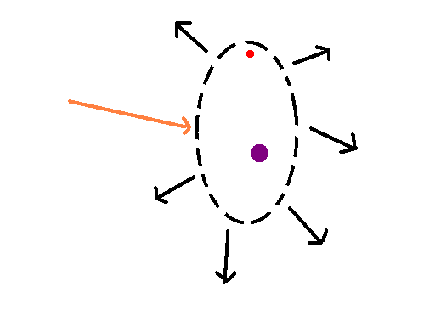
28.8 Why the Sky is Blue
Nitrogen and oxygen molecules ring like tiny bells with high frequency when energized by sunlight.
Reemit light in all directions like the sound of a bell.
Incident Beam
Atom
Scattered Radiation

Slide 20
28.8: cont…
Ultraviolet light from the sun is absorbed by the protective layer of the ozone gas.
Visible frequencies of violet light is scattered.
Although the violet light is scattered more, our eyes are only sensitive to blue. That’s why we see a blue sky.

Slide 21
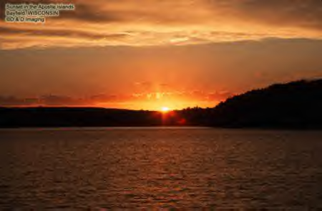
28.9: Why Sunsets are Red

Slide 22
28.9: cont…
Lower frequencies of light are scattered the least by nitrogen and oxygen molecules
→ Red, orange, yellow are transmitted more readily through the atmosphere
Light of lower frequencies is transmitted while light of higher frequencies are scattered

Slide 23
28.9: cont…
At dawn and sunset, the sunlight reaches the earth at a longer path
At noon, the light travels the least
Blue light is scattered as the path of the sunlight becomes longer

Slide 24
28.10: Why Water is Greenish Blue
Water is transparent to almost all the visible frequencies of light.
The color is actually the reflected color of the sky
Red is absorbed by the molecules in the water

Slide 25
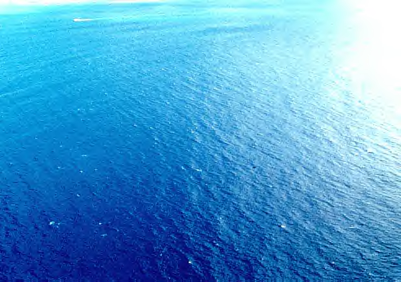

Slide 26
28.11: The Atomic Color Code- Atomic Spectra
Every element has its own specific glow
The light from the elements can be analyzed by a spectroscope
It is composed of thin slits, lenses, and a prism
It displays the spectrum of light
Line spectrum- images of the slit through which the light passes

Slide 27
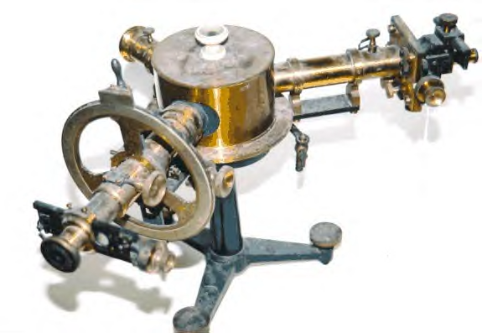
Spectroscope

Slide 28
THE END

